Slide 1

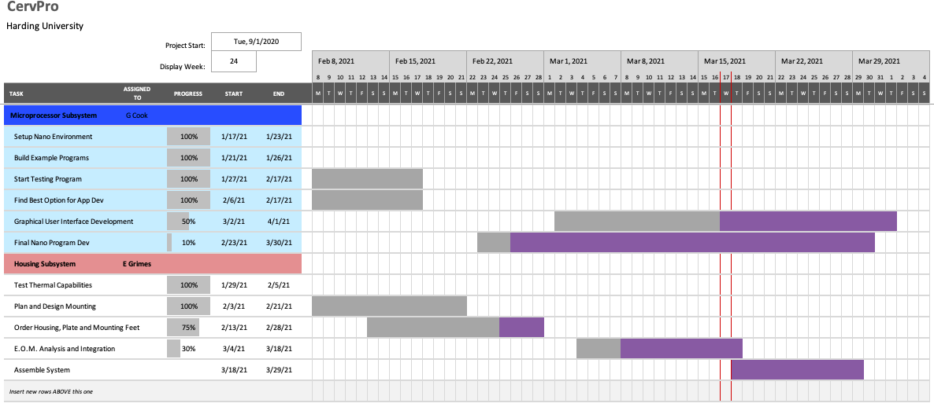

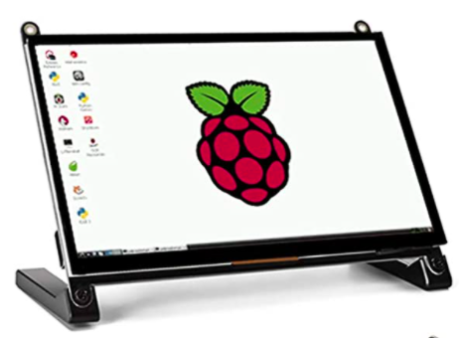
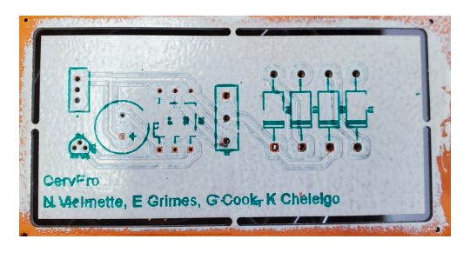
CervPro
Cervical Proprioception Diagnosis: A3 Status
Date: January 21, 2021
Members: Nathan Vielmette, Ethan Grimes, Keneth Chelelgo, and George Cook
Background
PT cervical proprioception (CP) assessments are subjective and determined by PT opinion.
Motivation is to create device that gives PTs objective data that shows patients’ ability to sense head and neck position in space.
Device will sense head position and angular velocity.
Proposed Countermeasures
Design the interface to be 2 windows instead
Find new screws at local hardware stores
Explore alternative screens or find different vendor for same screen
Recent Results
PCB is fully fabricated and tested
Enclosure and mounting panel arrived
All components have been fit and size tested within enclosure
Exposure corrected for dark faces
Current Conditions
Goals/Targets
Use of device will be faster than double standard CPE test time
Patient will not need to touch any part of device
Accurately measures head position and speed within 5% error margin
Device will be movable and <10lbs
Next Steps
Mount PCB in enclosure (Nathan)
Finish GUI v2 (George)
Prepare program for E.O.M. implementation (George and Ethan)
Order PCB mounting feet and LCD touch screen (Ethan)
Analysis
Original design for user interface is not working
Stock screws for mounting plate do not fit stock holes
Chosen LCD touch screen for user interface is out of stock

Slide 2
CervPro
Cervical Proprioception Diagnosis: A3 Status
Date: January 21, 2021
Members: Nathan Vielmette, Ethan Grimes, Keneth Chelelgo, and George Cook

Slide 3
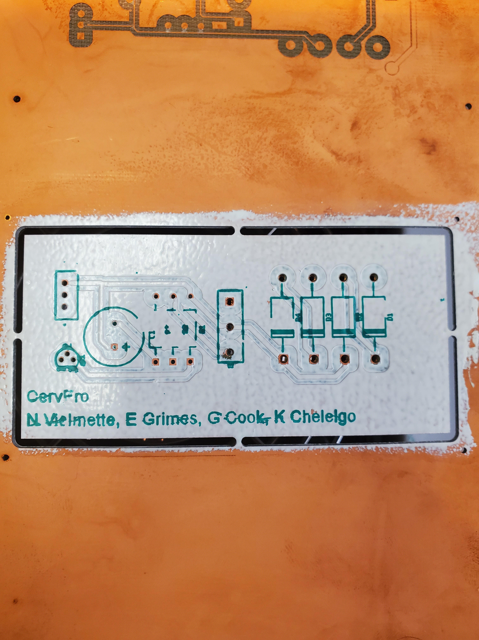
CervPro
Cervical Proprioception Diagnosis: A3 Status
Date: January 21, 2021
Members: Nathan Vielmette, Ethan Grimes, Keneth Chelelgo, and George Cook

